Slide 1
Superresolution Microscopy by Single Molecule Switching and Localziation
Kurt Thorn
Nikon Imaging Center, UCSF

Slide 2
The Resolution Limit in Light Microscopy
Diffraction spot
on image plane
(resolution)
Intermediate image plane
Objective
Tube lens
Sample
α
Back focal plane aperture
Image resolution improves with Numerical Aperture (NA)
NA = n sin(α)
= light gathering angle
n = refractive index of sample
where:

Slide 3
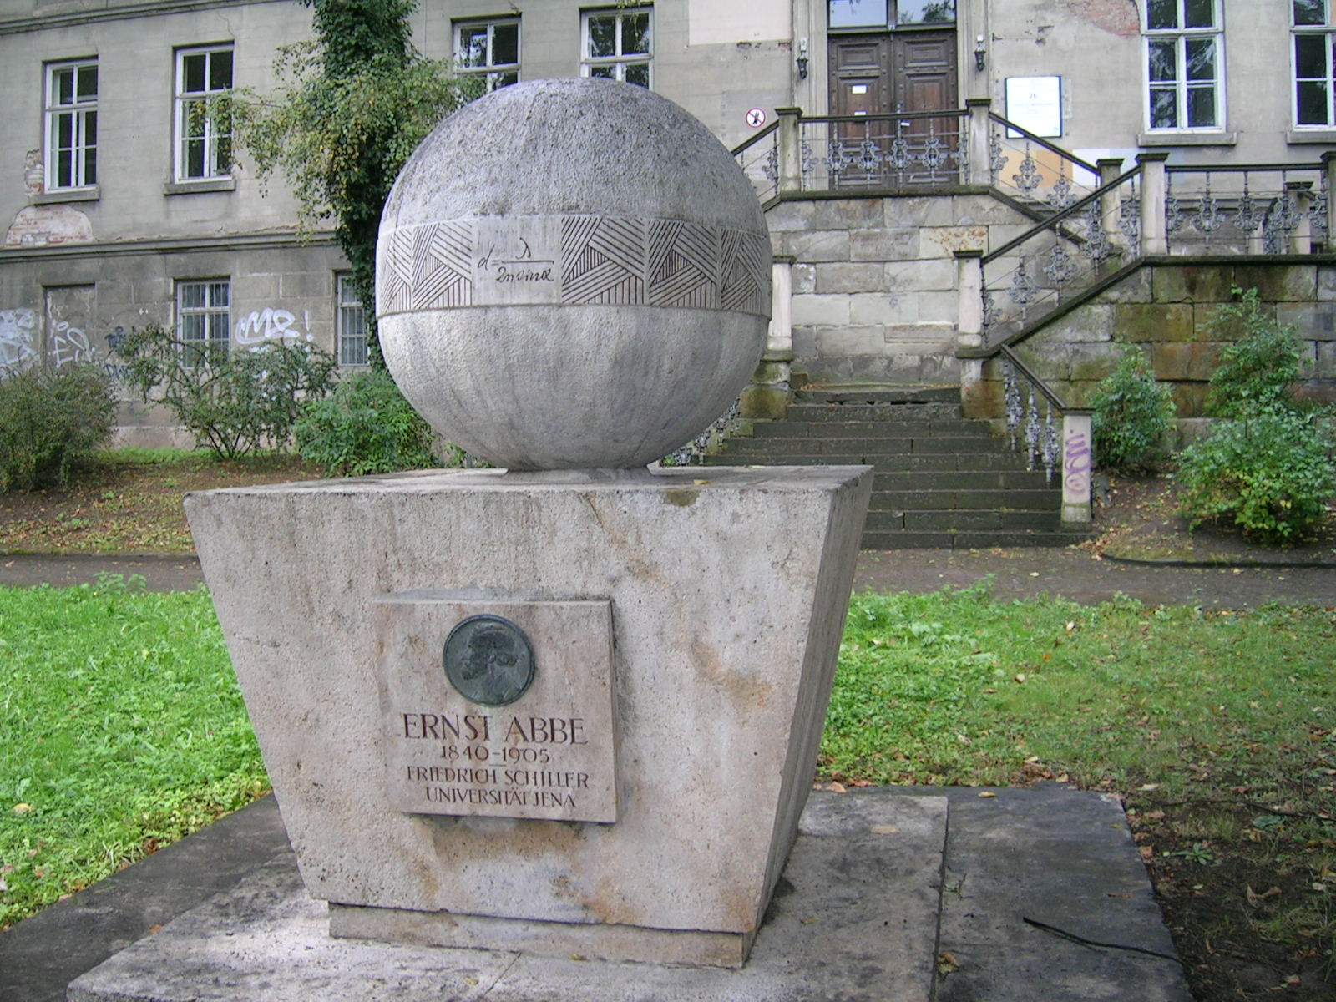
The Resolution Limit in Light Microscopy

Slide 4
Improving The Resolution Limit in Light Microscopy
d = λ / 2n sin α
To improve resolution (smaller d):
Use smaller λ – UV objectives
Use larger n – Sapphire coverslips
Use larger α – 4pi / I5M
Objective
α
Sample
α
Objective

Slide 5
Improving The Resolution Limit in Light Microscopy
d = λ / 2n sin α
What does this assume?
Uniform illumination
Continuous sample
What if we break it?
Structured illumination
Localize single molecules (PALM/STORM/etc.)

Slide 6
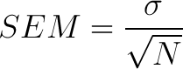
How does imaging single molecules help us?
Imagine taking a measurement
Multiple times
Adding measurements improves our ability to estimate the mean

Slide 7
How does imaging single molecules help us?
Can measure the center of a distribution higher accuracy than any single measurement

Slide 8
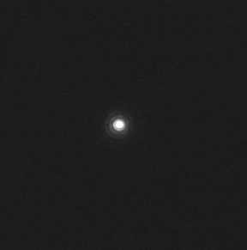
How does imaging single molecules help us?
Can measure the center of a distribution higher accuracy than it’s width.
Can determine the center of a single molecule to much higher accuracy than it’s width.

Slide 9
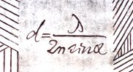

Single-molecule localization precision
1 photon
D ≈ d / √⁻N
10 photons
100 photons
1000 photons

Slide 10
Single molecules can be precisely localized
How can we apply this to imaging?
Problem: in our image, we can’t see single molecules – we see lots and lots of molecules and we can resolve them from each other.
What if we could turn off all the molecules, and then turn them on a few at a time?

Slide 11

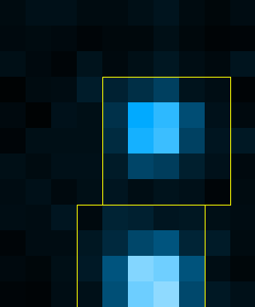
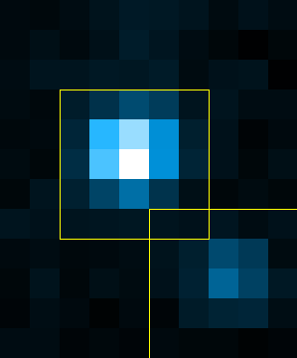


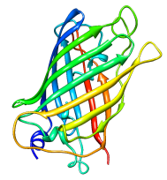
Super-resolution by localization
Fluorescence image
Raw images
STORM Image
Deactivation
Activation
Localization
Photoswitchable molecules
N
+
N
2x real time
Stochastic Optical Reconstruction Microscopy = STORM
Also named as PALM (Betzig et al., Science, 2006) and FPALM (Hess et al., Biophys. J. 2006)
Rust, Bates & Zhuang, Nat. Methods, 2006 Bates, Huang, Dempsey & Zhuang, Science, 2007

Slide 12
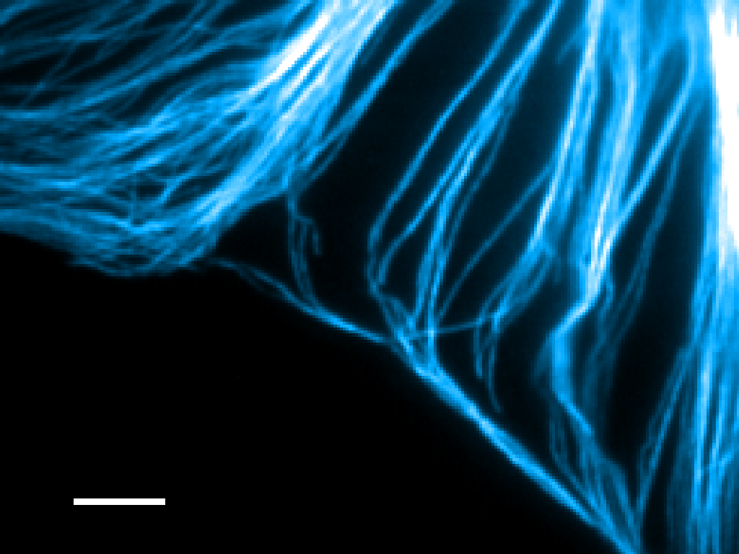
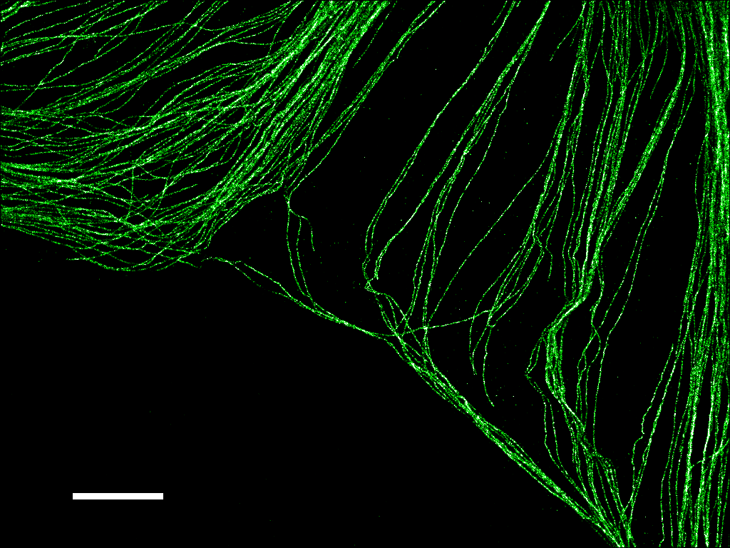
Reconstructed from 40,000 frames, 3,350,370 localization points
5 μm
B-SC-1 cell,
Microtubules stained with anti-β tubulin
Cy3 / Alexa 647 secondary antibody
Bates, Huang, Dempsey and Zhuang, Science, 2007
Notes:
Explanation of labeling, immunostaining procedure slides (animation)

Slide 13
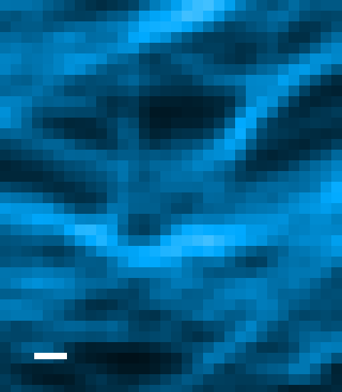
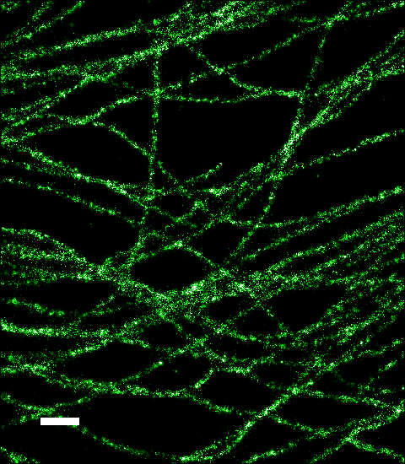
500 nm
5 μm
Bates, Huang, Dempsey and Zhuang, Science, 2007

Slide 14
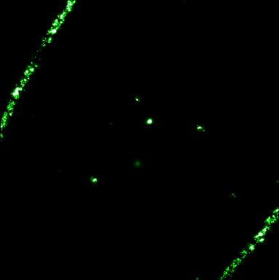
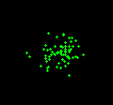
FWHM ≈ 320 nm
FWHM = 24 nm
stdev = 10 nm
5 μm
Bates, Huang, Dempsey and Zhuang, Science, 2007
Notes:
Explaining resolution in 3D only?

Slide 15







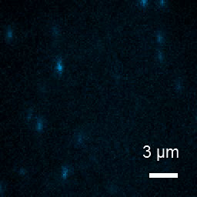



3D Imaging: Localization in the Third Dimension
In focus
(x, y, z)
(x, y)
z (nm)
400
Scan z = -600 to 600 nm
200
0
-200
2γ
EMCCD
-400
Huang, et al., Science, 2008
Notes:
Having all three on at the same time, changing color

Slide 16
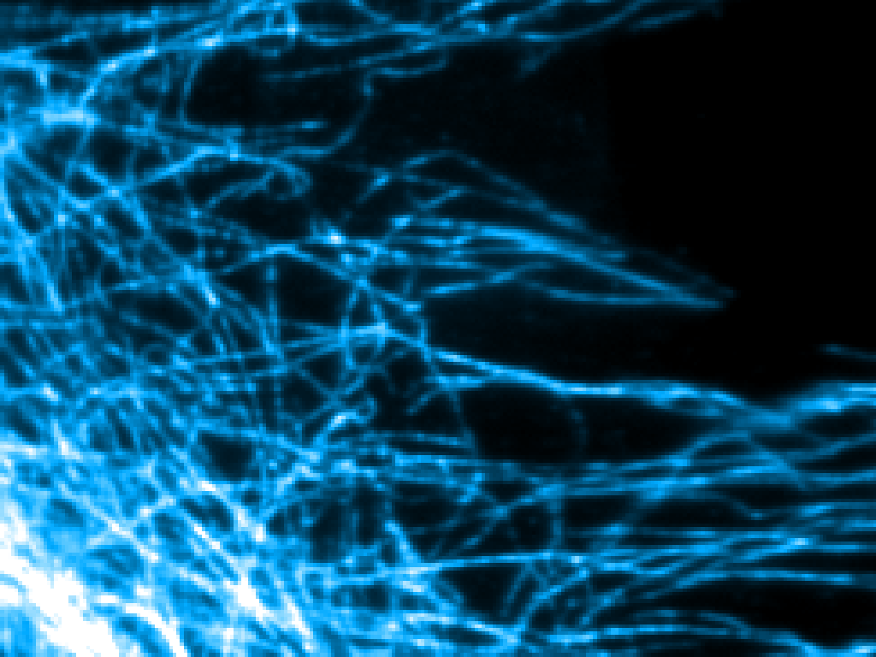
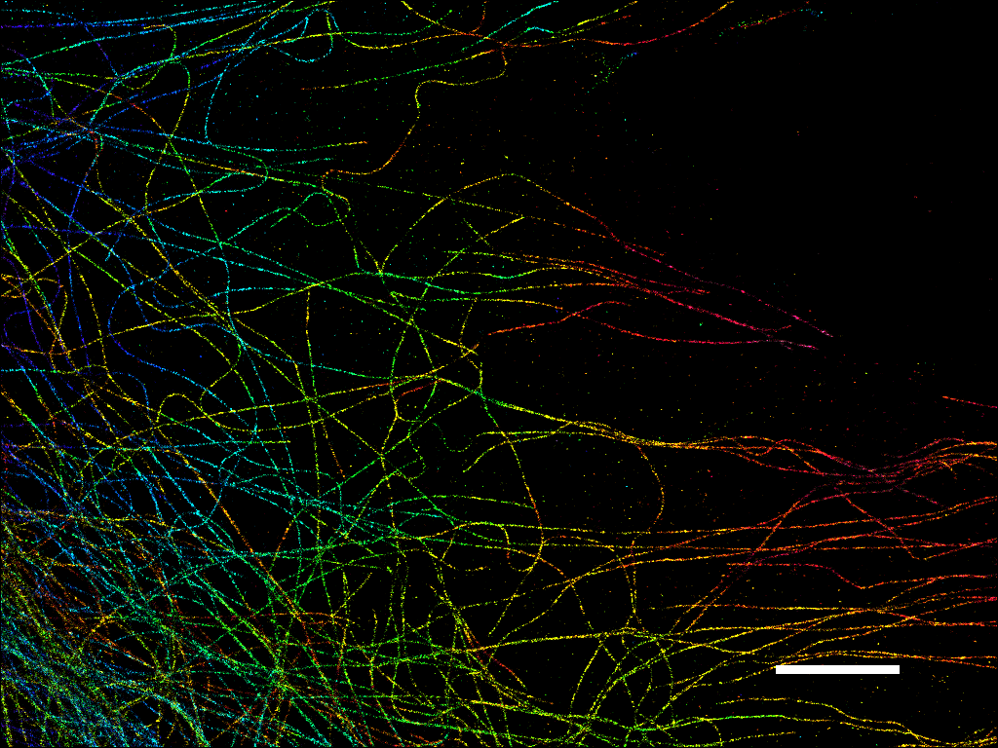
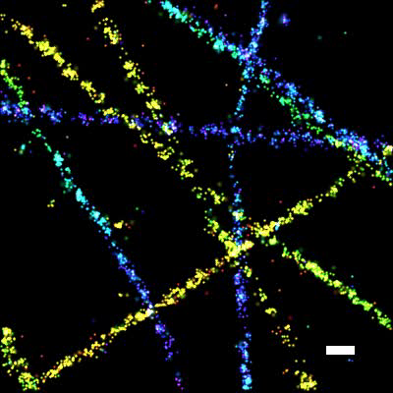

3D Imaging of the Microtubule Network
z (nm)
600
300
0
Scale bar: 200 nm
5 μm
Huang, Wang, Bates and Zhuang, Science, 2008
Notes:
No “two-layer”, just say the whole thing is 400 nm, cannot be resolved by confocal.

Slide 17
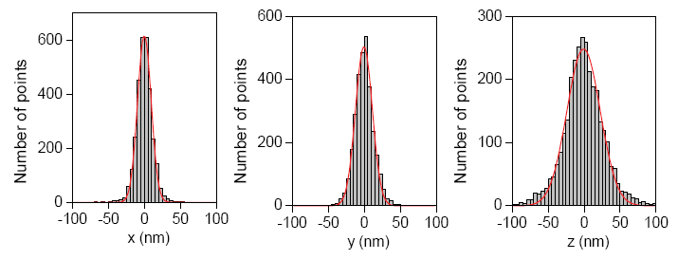
3D Imaging of the Microtubule Network
z (nm)
600
Small, isolated clusters
300
FWHM
22 nm
28 nm
55 nm
0
5 μm
Huang, Wang, Bates and Zhuang, Science, 2008
Notes:
No “two-layer”, just say the whole thing is 400 nm, cannot be resolved by confocal.

Slide 18
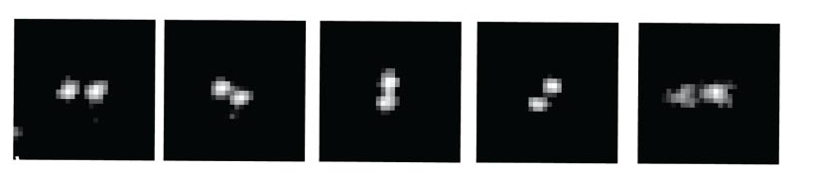
Other 3D localization method
Astigmatic imaging
(x, y, z)
(x, y)
z (nm)
-400
-200
0
200
400
Huang et al., Science 2008
Bi-plane imaging
SLM
Juette et al., Nat Methods 2008
Double-helical PSF
EMCCD
EMCCD
z (nm)
-900
-500
0
600
1400
Pavani et al., PNAS 2009

Slide 19
Super-resolution by localization
Combines two ideas:
Localization Microscopy
Single Molecule Switching

Slide 20
Single-Molecule Switching Approaches
Lots of acronyms:
PALM
FPALM
STORM
dSTORM
GSDIM
PALMIRA
SMACM
PAINT
SPRAIPAINT
All use single-molecule localization
Main differences are how you switch the molecules on and off

Slide 21
Single Molecule Switching using Fluorescent Proteins
PALM, FPALM
Photoactivatible molecules: PA-GFP, PA-mCherry, PA-TagRFP
405nm
OFF
ON
Photoconvertible molecules: mEos2/3, PS-CFP2, PSmOrange
405nm
Green
Red

Slide 22
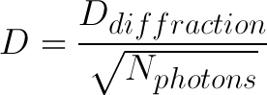
Parameters for evaluating dyes
Number of photons emitted before bleaching / blinking
Contrast ratio – brightness of ON state relative to OFF state

Slide 23
Why Contrast Matters
405nm
OFF
ON
OFF
What if your OFF state isn’t completely off?
Can no longer distinguish single molecules above background

Slide 24
Fluorescent Proteins for Single Molecule Switching
Protein | λex | λem | Contrast Ratio | Nphotons (median) | Notes
PS-CFP2 | 490 | 511 | 2000 | 260 | Cyan-to-green
mGeos-M | 503 | 514 |  | 387 | Reversibly photoactivatible
PATagRFP | 562 | 596 | 540 | 500? | Photoactivatible
PAmCherry | 564 | 595 | 4000 | 348 | Photoactivatible
tdEos | 569 | 581 |  | 499 | Green-to-red
mEos2 | 573 | 584 |  | 379 | Green-to-red
mEos3.2 | 572 | 580 |  | 482 | Green-to-red
PSmOrange | 631 | 662 | 10700 | 337 | Orange-to-far red
Full table at http://nic.ucsf.edu/dokuwiki/doku.php?id=storm:fps

Slide 25
Multi-color and FPs
405nm
OFF
ON
405nm
e.g. PA-GFP, mGeos-M
Cyan
Green
405nm
Green
Red
e.g. PS-CFP
405nm
e.g. mEos2/3
Red
FarRed
405nm
OFF
Red
e.g. PSmOrange
e.g. PA-TagRFP, PA-mCherry

Slide 26
Single Molecule Switching Using Small Molecule Dyes
STORM, dSTORM, GSDIM
Singlet states
Triplet states
S₁
λ_{em}
T₁
λ_{exc}
S₀

Slide 27
Single Molecule Switching Using Small Molecule Dyes
STORM, dSTORM, GSDIM
Singlet states
Triplet states
S₁
T₁
λ_{exc}
S₀

Slide 28
Single Molecule Switching Using Small Molecule Dyes
STORM, dSTORM, GSDIM
Singlet states
Triplet states
Other dark states
S₁
T₁
λ_{exc}
S₀
Dark states can be long-lived

Slide 29
Single Molecule Switching Using Small Molecule Dyes
STORM, dSTORM, GSDIM
The idea:
Drive the majority of molecules into a dark state
Use high laser power
Special buffers
Wait for molecules to spontaneously return to ground state
Image them until the bleach or return to dark state

Slide 30
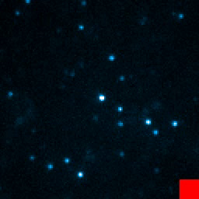
Photoswitching of red cyanine dyes
650 nm
Fluorescent
N
+
N
+ thiol
Cy5 / Alexa 647
photoactivation
Deactivation
360 nm
650 nm
Dark
Bates eta l., PRL 2005, Bates et al., Science 2007, Dempsey et al., JACS 2009

Slide 31
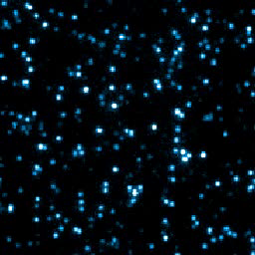
Multicolor Single Molecule Switching: Activation
650 nm
Fluorescent
Cy5
Cy3
photoactivation
Deactivation
360 nm
650 nm
Dark
Cy5
532 nm
Cy3

Slide 32
Controlling the activation of Cy5
650 nm
Fluorescent
Cy5
532
457
405 nm
Activation pulses
Cy3
photoactivation
Deactivation
Cy2
Fluorescence
Alexa 405
Dark
0
1
0
t
i
m
e
(
s
)
2
0
3
0

Slide 33
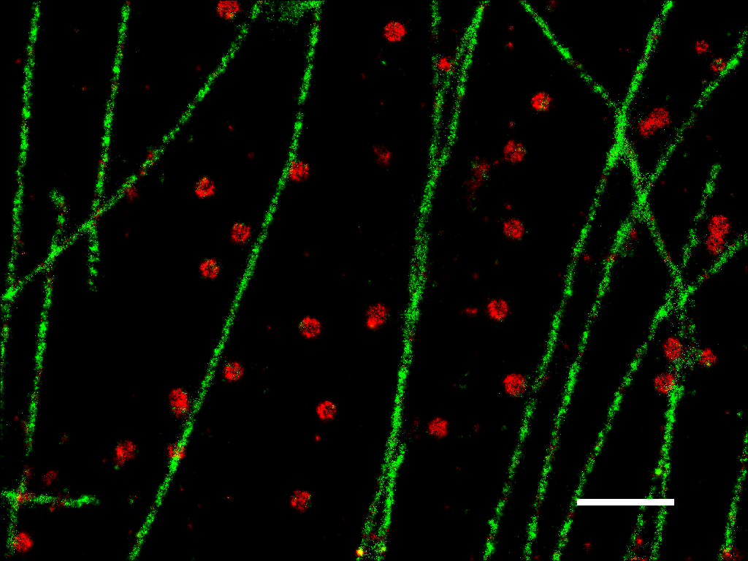
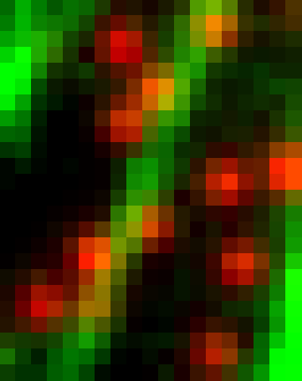
█ Cy3 / Alexa 647: Clathrin
█ Cy2 / Alexa 647: Microtubule
Crosstalk subtracted
Laser sequence
Cy3
A647
Cy2
A647
…
532
457
…
1 μm
Bates, Huang, Dempsey and Zhuang, Science, 2007

Slide 34
Multicolor Single Molecule Switching: Emission
Singlet states
Triplet states
Other dark states
S₁
T₁
λ_{exc}
S₀
If you use high enough laser power, many molecules can be driven to the dark state
Cy3B, Atto488, …
See Dempsey et al. Nat. Meth. 2011, p. 1027

Slide 35
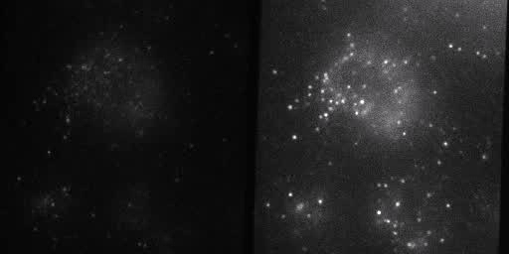
Multicolor STORM/PALM
561 nm
642 nm
mEosFP2
Alexa647
575 nm
675 nm
635DRLPXR

Slide 36
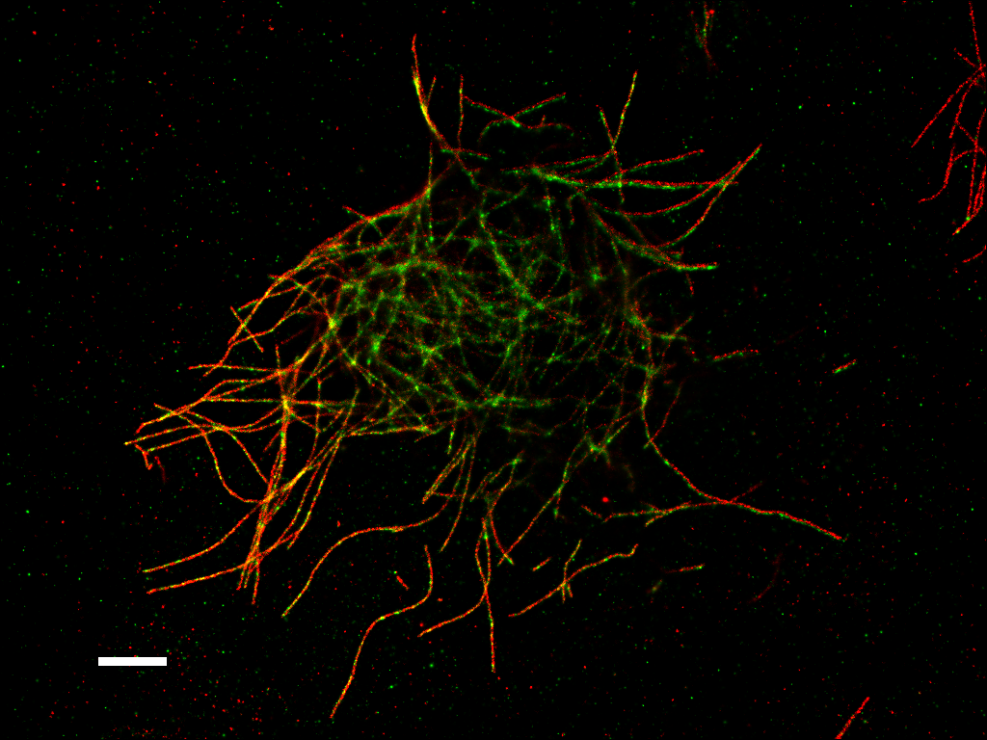
mEos2-tubulin
Alexa 647 anti-β tubulin
Drosophila S2 cells
2 µm
Daichi Kamiyama

Slide 37
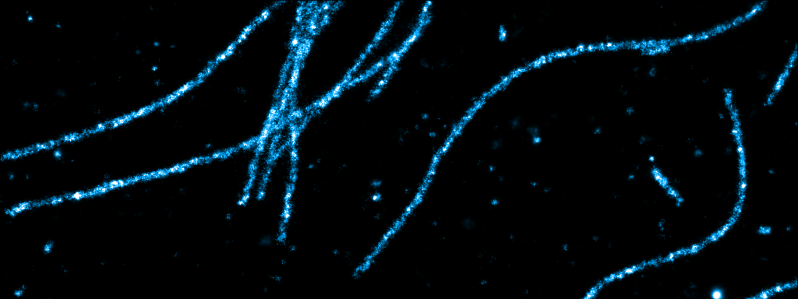
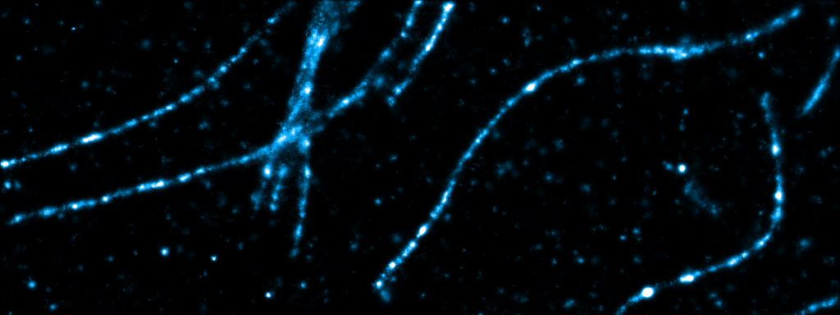
Alexa 647 – anti β tubulin
mEos2 tubulin
Daichi Kamiyama

Slide 38
An alternative strategy: time slicing
Use a multi-pass emission filter
Alternate laser excitation so that every other frame is a different dye.
Cy3B
A647
…

Slide 39
Multicolor imaging approaches
By emission wavelengths
By activation wavelengths
Simple fluorophores
Low crosstalk
Continuous imaging
Multi-channel detection optics
Needs nanometer scale image alignment
Dye-pairs
Crosstalk from nonspecific activation
Laser sequences
Single channel detection
Images naturally aligned

Slide 40
Summary: Labeling Strategies
Fluorescent proteins
mEos is a good starting point
Multicolor may be challenging
Cy5 / A647 plus activator dyes
Need to label your own antibodies
Crosstalk a problem
Dyes driven to dark state
Need high laser power
Photoswitchable / photoactivatible dyes
Not many options yet (Aberrior)

Slide 41
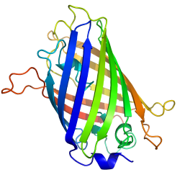
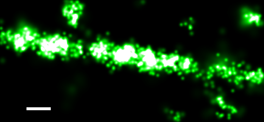
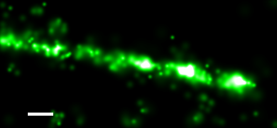
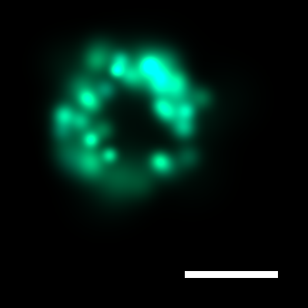
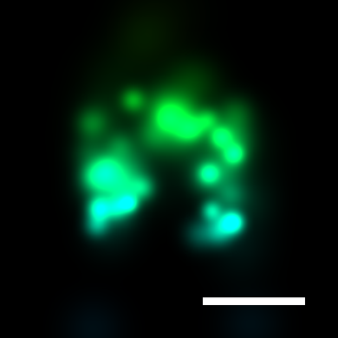
Effective resolution: Probe matters
Antibodies: ~ 10 nm
Fluorescent Proteins: ~ 3 nm
Small fluorophores: ~ 1 nm
Measured FWHM by antibody: 58 nm
Actual microtubule diameter: 25 nm
Measured FWHM by antibody: 58 nm
Actual microtubule diameter: 25 nm
Measured FWHM by FP: 43 nm
100 nm
100 nm
100 nm
~ 6000 photons
< 1000 photons
~ 6000 photons

Slide 42
Fluorescent protein vs. Antibody
Fluorescent protein fusion
Antibody immunofluorescence
Live sample labeling
High specificity
High labeling efficiency
Genetically encoded
Lower S/N
Multicolor imaging so far challenging
Fixed sample
Potential nonspecific labeling
Lower labeling efficiency
Labeling endogenous proteins
High signal = high localization precision
More versatile for multicolor imaging

Slide 43
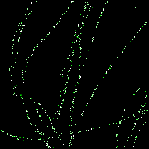
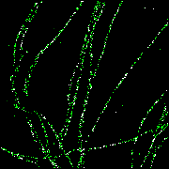
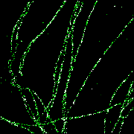
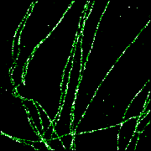
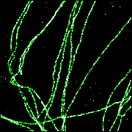
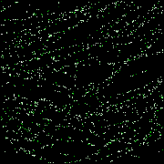
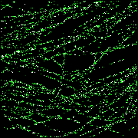
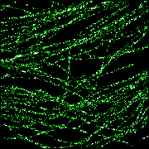
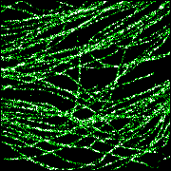
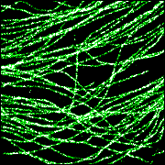
Effective resolution: Density matters
Frames for image reconstruction:
200
500
1,000
5,000
40,000
Nyquist criteria
Point to point distance ≈ Feature size
Point to point distance < ½ Feature size
This labeling density limit of resolution applies to all fluorescence microscopy methods

Slide 44
Other issues
Sample drift
Dedrifting by cross-correlation
Fiducial markers (gold particles, beads)
Fixing
Background fluorescence
Sample preservation

Slide 45
Acknowledgements / Further Reading
Bo Huang
http://nic.ucsf.edu/dokuwiki/doku.php?id=storm
Lots of papers

